Slide 1
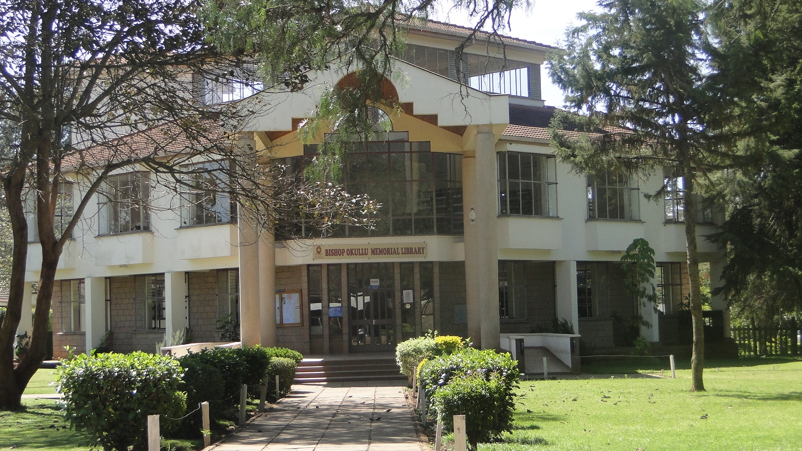
ST. PAULS UNIVERSITY
BISHOP OKULLU MEMORIAL LIBRARY

Slide 2
VISION
To be a centre of knowledge and global information
MISSION
Acquire current and relevant education resources and provide information access through service delivery for the development of servant leaders

Slide 3
CAMPUS LIBRARIES
Bishop Okullu Memorial Library.
Main Campus Limuru
Nairobi Campus
Machakos Campus
Nakuru Campus

Slide 4
MEMBERSHIP
Data provided by Registry
Library account opened and activated
Membership of the library in the campus where you are enrolled as a student
NOTE: Membership includes all registered students of the university, Faculty and other members of staff

Slide 5
BORROWING
Information materials in PERIODICALS, REFERENCE, ARCHIVES, SPECIAL COLLECTION can NOT be borrowed out. They can only be used within the library
ALL information materials in GENERAL CIRCULATION may be borrowed and used out of the library
Information materials in RESERVE COLLECTION can only borrowed strictly for 2hrs or overnight (5pm-9am)

Slide 6
LOAN PERIODS
Doctoral Students
8 books for 1 month
Renewed once
Masters Students
5 books for 1 month
Renewed once
Undergraduates
5 books for 2 weeks
Renewed once

Slide 7
RULES AND REGULATIONS
All library users are expected to strictly observe these rules and regulations. Any breach will result in disciplinary action
No user shall take a book out of the library unless it is properly issued.
Borrowed items shall not be transferred from one borrower to another but shall first be returned to the library for any such transfer to take place.
Borrowers are held responsible for the safe custody of any library material they borrow. They shall be required to pay the cost of replacement plus 20% administrative cost of any item lost or damaged while on loan to them.
Each student is required to have and show his/her ID when entering the library and when borrowing library materials.
Borrowers are required to return borrowed materials on or before the due date. A fine, per day per book is charged for late return of circulating books and per hour per book for late return of reserve books.

Slide 8
cont: RULES AND REGULATIONS
Readers must not damage or deface books or any other library materials. Those who do this will be required to pay replacement cost.
Books once removed from the shelves should not be re-shelved. They should be left on the reading tables for library staff to re-shelve them.
The library is noise-free environment. Making noise in the library is not allowed.
The library is a smoke-free environment. Smoking in the library is strictly prohibited.
Eating, drinking and chewing in the library is prohibited
Use of mobile phones in the library reading areas is not allowed. Maintain your phone on silent mode when in the library.
Use of library computers is strictly for the OPAC and online database searches.
All bags should be left at the library luggage area.
DO NOT LEAVE VALUABLES IN THE LUGGAGE AREA OF THE LIBRARY. IF YOU DO SO, IT IS AT YOUR OWN RISK!!

Slide 9
LIBRARY SERVICES
Lending
Of books and other information materials
Of course reserved books (those in short loan section)
Information Literacy
On use of OPAC
On use of E-books and E-journals
Information Services
Assistance with general enquiries for information
Current Awareness for new books, magazines and journals added to the library collection
Remote Access

Slide 10
Cont: LIBRARY SERVICES
Photocopying
Done with adherence to the Copyright Act
Done at a small fee
Inter-library Loan
Working with other libraries to facilitate use of their libraries and resources for the benefit of our members
Binding
Of Theses and dissertations

Slide 11
Library Collection
Print Materials
Books
Newspapers
E-Books (online)
Ebrary Ebooks
E-Journals (Online)
AJOL
Journals
Magazines
Research Papers and Theses
Special Collection
Photos
Government Publications
OECD Books and Monographs (PDF)
Onlinebooks
Taylor and Francis Ebooks
BMJ Journals
Cambridge Journals
Chicago
Ebscohost Databases
E-LIS
Emerald Journals
HINARI
JSTOR
OECD Periodicals
SAGE
Oxford University
OTHERS

Slide 12
LIBRARY STAFF
Limuru Campus
Chantal Bunei
Kenneth Rotich
Oliver Kisia
Emily Sirorei
Jane Lilan
Lucy Kamau
Susan Cherono
Nellie Odiowuor
Daniel Manyansi
Damaris Awinja
Rolex Opondo
Wako Dalacha
Thomas Oluoch
Monica Chemeli
Nairobi Campus
Davis Mutaki
Essy Neema Reuben
Nakuru Campus
Jackson Kimani
Damaris Wambugu
Machakos Campus
Peter Gichiri
Muthoni Kibandi

Slide 13
CONTACTS
University Librarian or Circulation
Bishop Okullu Memorial Library
Tel:020 2020 505 /10
Mobile: 0728 669000 / 7364 214440
Ext.. 240 & 110
librarian@spu.ac.ke
libcirculation@spu.ac.ke
libacquisitions@spu.ac.ke
libprocessing@spu.ac.ke
libarchives@spu.ac.ke
libict@spu.ac.ke
askalibrarian@spu.ac.ke
END

